Slide 1
Project
Analyze Survey Data

Slide 2
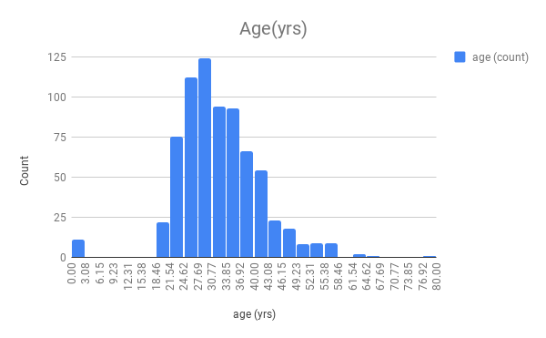
Age
<visualization or summary statistics used for finding>
This is a histogram. Here, it is visible that the most common age group of the survey respondents falls around 27 years. We have the mean around 32 years, median at 31 years, mode at 29 years. We can conclude that mean and the median have been affected by outliers a little but not to a great extent.
The standard deviation is 9.05 and the range of ages covered is 76 years, indicating a reasonable age group of the Udacity Survey Respondents.

Slide 3
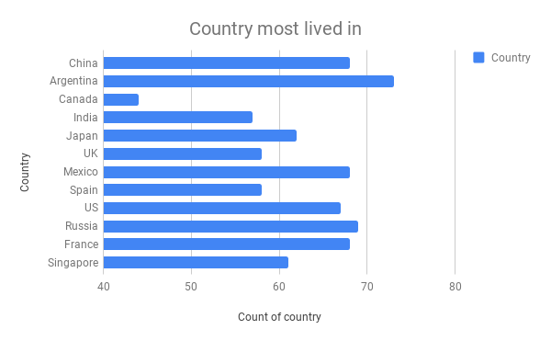
Country most lived in
<visualization or summary statistics used for finding>
From this bar chart, we can easily notice that most of the Udacity students are from the country Argentina, as it has the highest count which above 70.
Note: This data is from Survey Respondents and is not from the entire Udacity Student population.

Slide 4
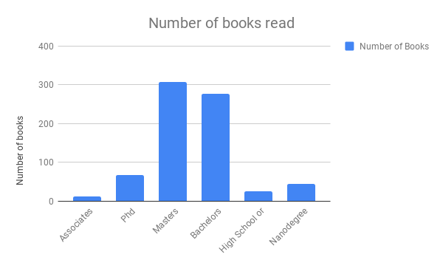
Number of books read
<visualization or summary statistics used for finding>
From this column chart, it looks like the group ‘Masters’ has appeared to read more number of books than any educational group. This is categorical type of data.

Slide 5
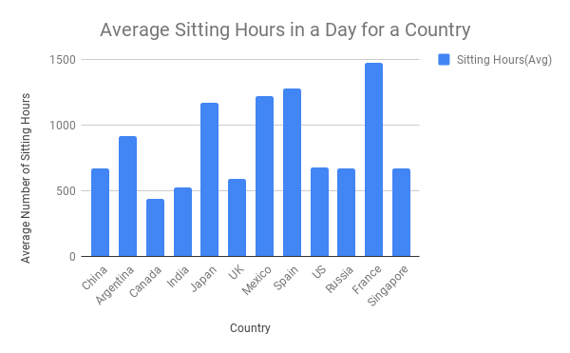
Sitting hours
<visualization or summary statistics used for finding>
Here, the average sitting hours in a day for a country have been analyzed. It is found that the country France has the highest number of sitting hours in this chart. The least country in this case, Canada. This is categorical data, and the measures of central tendency are not possible.

